Slide 1

Basic Cryptography and Bitcoin

Slide 2

Agenda
Hash functions, symmetric and asymmetric encryption, private and public keys
RSA and ECC
Bitcoin basics
Advanced scripting
Exercise
https://github.com/sofitto/bitcoin-workshop

Slide 3
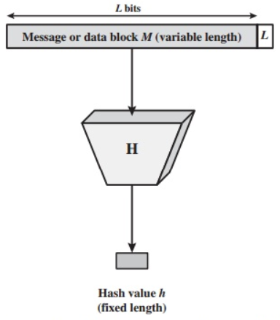
Hash functions
Computationally efficient: the computational time and power needed to transform input into output is very limited.
Hide information about the input: in contrast to previous property, it is very hard to obtain information on the input given the output.
The output should look random: minor changes in the input will generate a completely distinct and well-distributed output. It is impossible to see a direct link between the input and the output.

Slide 4
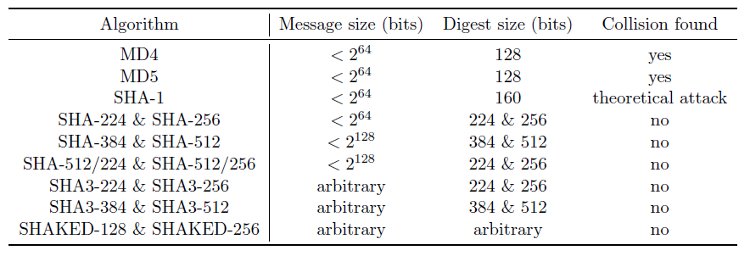
Hash functions
Bitcoin – SHA-256, RIPEMD-160
Ethereum – Keccak-256 (not NIST standard SHA-3)

Slide 5
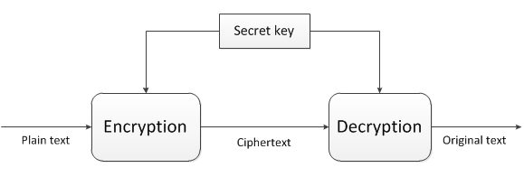
Symmetric encryption
3DES, AES and many more…
Main weakness: the key should be shared between parties

Slide 6
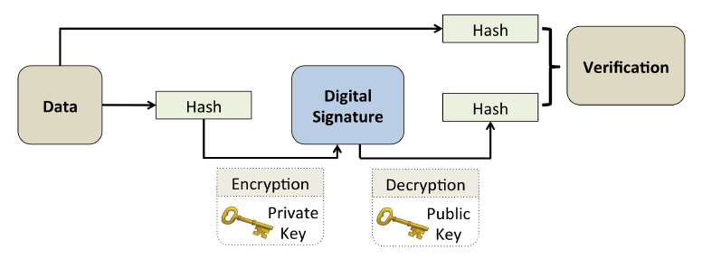
Asymmetric encryption
Encryption and decryption are performed with different keys: a private and public key.
The private key or signing key (SK) is known only to the owner of that key. The public key or verification key (VK) is visible to all users in the network.

Slide 7
Asymmetric encryption
Security(Bits) | Minimum size (bits) of Public Keys |  |  | Key Size Ratio | Protection From Attack
 | DSA | RSA | ECC | ECC to RSA/DSA
80 | 1024 | 1024 | 160 | 1:6 | Until 2010
112 | 2048 | 2048 | 224 | 1:9 | Until 2030
128 | 3072 | 3072 | 256 | 1:12 | Beyond 2031
192 | 7680 | 7680 | 384 | 1:20
256 | 15360 | 15360 | 512 + | 1:30

Slide 8
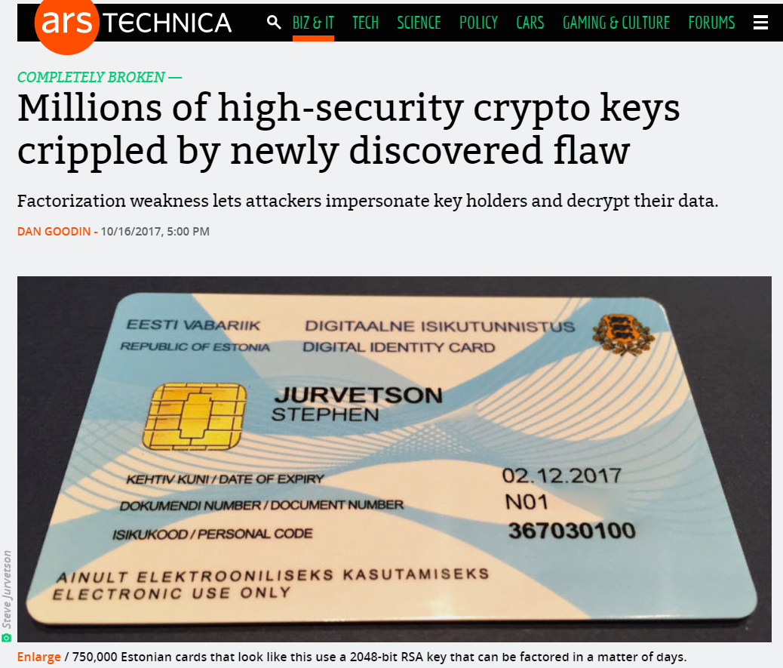
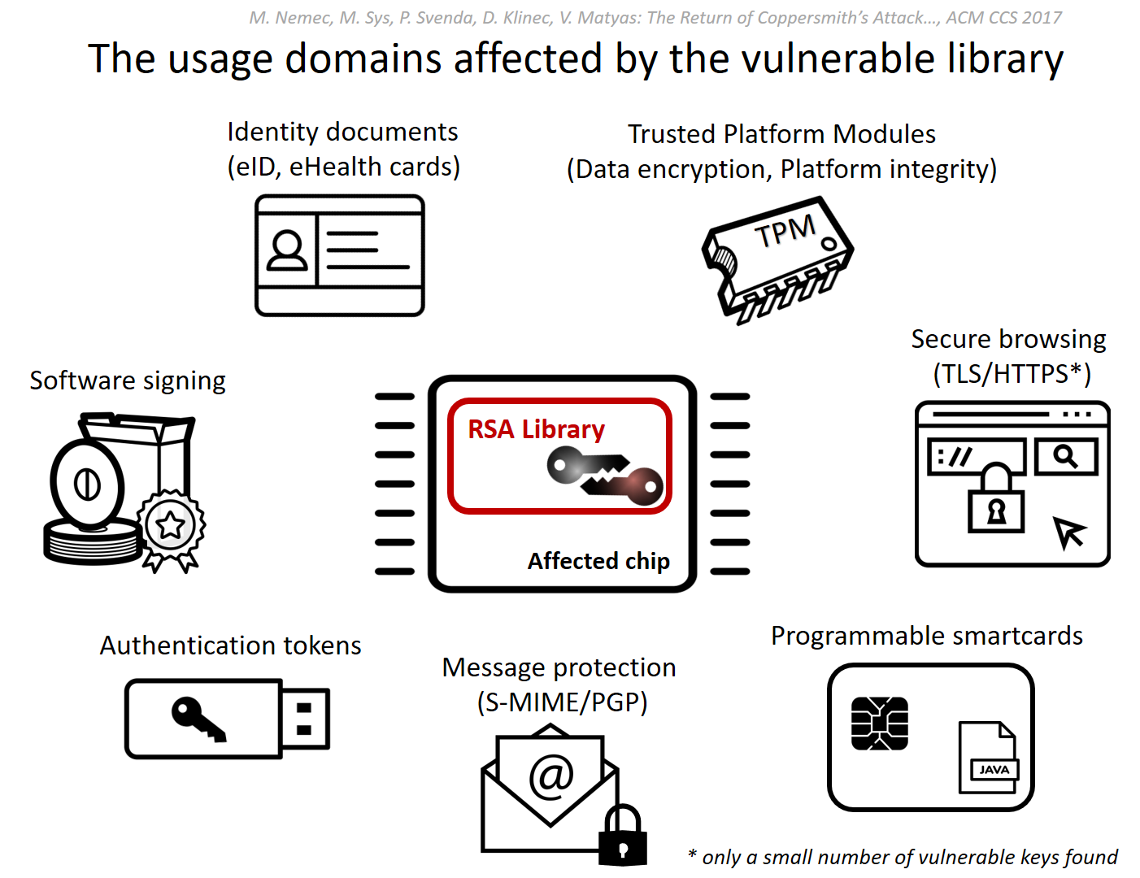
Recent problems with RSA
https://crocs.fi.muni.cz/public/papers/rsa_ccs17
https://arstechnica.com/information-technology/2017/10/crypto-failure-cripples-millions-of-high-security-keys-750k-estonian-ids/

Slide 9
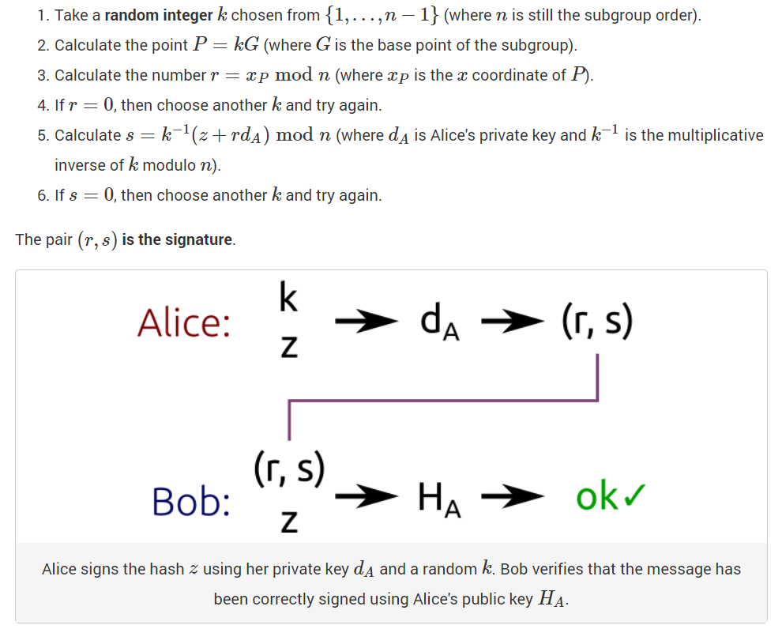
ECDSA “Under the Hood“
Sony PlayStation Hack:
https://youtu.be/4loZGYqaZ7I?t=35m45s
http://andrea.corbellini.name/2015/05/30/elliptic-curve-cryptography-ecdh-and-ecdsa/

Slide 10
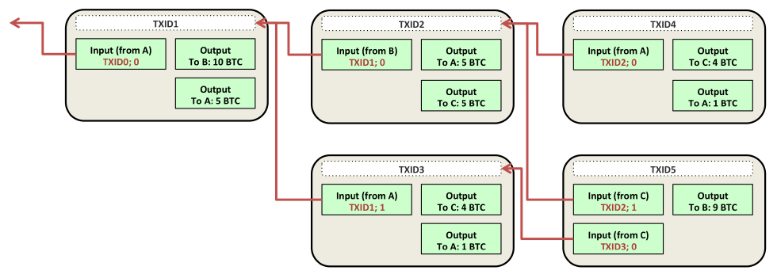
Bitcoin Blockchain (transactions)

Slide 11
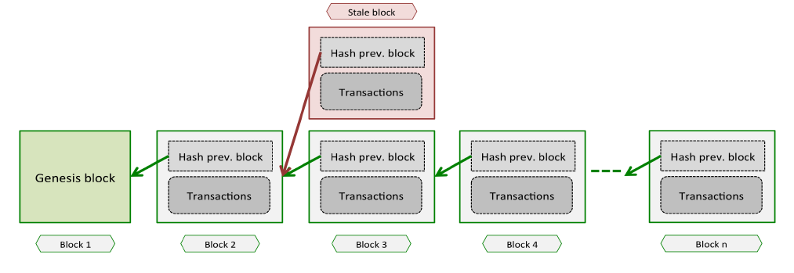
Bitcoin Blockchain
Everybody has a copy of the database
The database is (almost) append-only (i.e. data written is immutable)
The consistency of the database is easily verified as the system follows specific rules

Slide 12
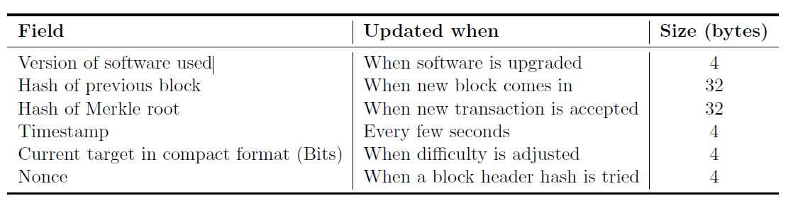
Bitcoin Blockchain (block header)

Slide 13
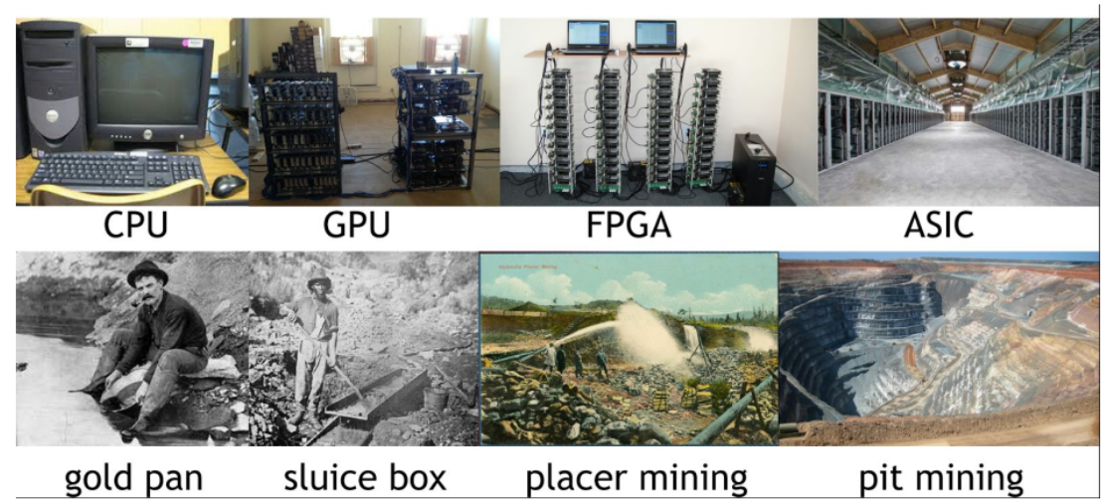
Bitcoin mining(searching for nonce)

Slide 14
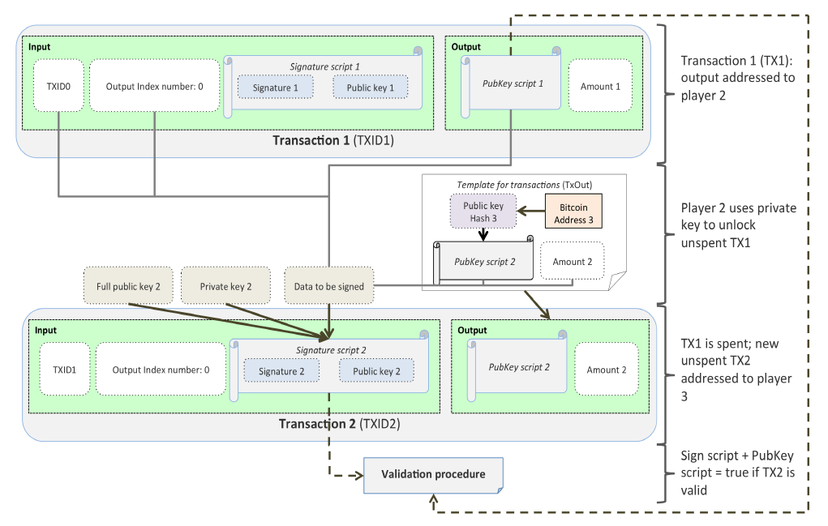
Bitcoin scripting (P2SH)

Slide 15
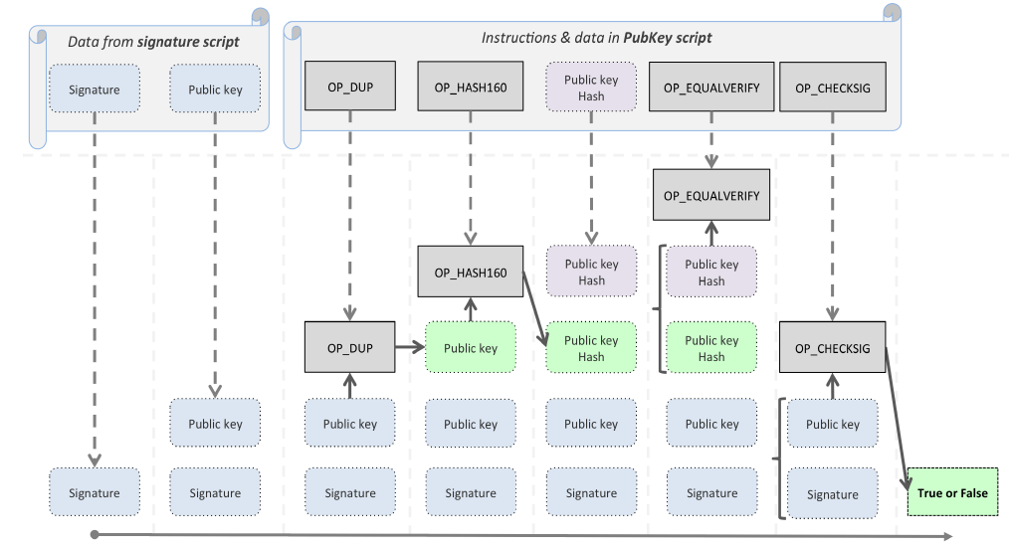
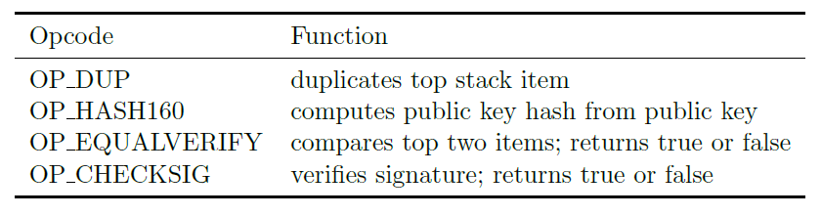

Slide 16
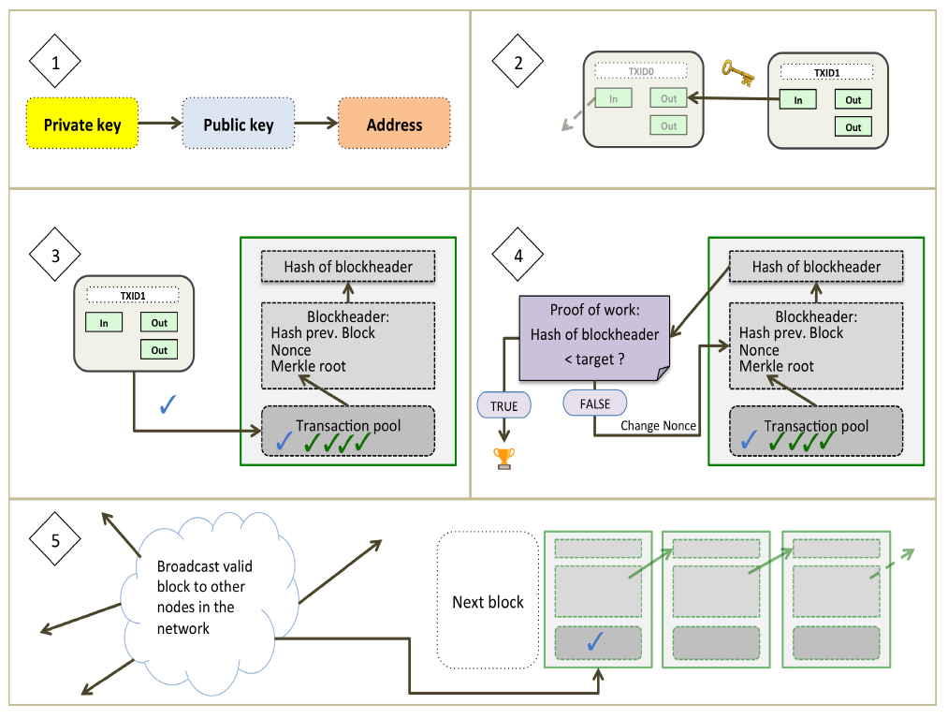
Different steps involved to transfer bitcoins

Slide 17
Links
Libraries:
https://github.com/bitpay/bitcore-lib - Bitcore (JavaScript)
https://github.com/bcoin-org/bcoin - Bcoin (JavaScript)
https://github.com/bitcoinj/bitcoinj - BitcoinJ (Java)
Wallets:
https://github.com/mycelium-com/wallet-android
https://github.com/greenaddress/GreenBits

Slide 18
Practical Exercise

